Slide 1
Comfort Furniture Website
A Full-Stack Web Development Project
Presented by:
Dhruv Panchal | Dev Patel | Devansh Makwana
Date: April 01, 2026

Slide 2
Project Overview
OBJECTIVE:
To design and develop a fully functional, responsive e-commerce website for 'Comfort Furniture.'
KEY FEATURES:
Responsive Design
User Interaction (Alerts, Prompts, Confirm)
Consistent Navigation Bar
5 Core Pages (Home, About, Contact, Login, Register)
TECHNOLOGIES:
HTML5 | CSS3 | JavaScript | Bootstrap 4.5 | Google Fonts

Slide 3
Home Page
Landing Page Design
HERO SECTION:
Welcome banner with call-to-action button
'Check Special Offer' triggers discount prompt
PRODUCT SHOWCASE:
3 product cards in responsive grid
Modern Sofa ($599) | Office Chair ($199) | Dining Table ($399)

Slide 4
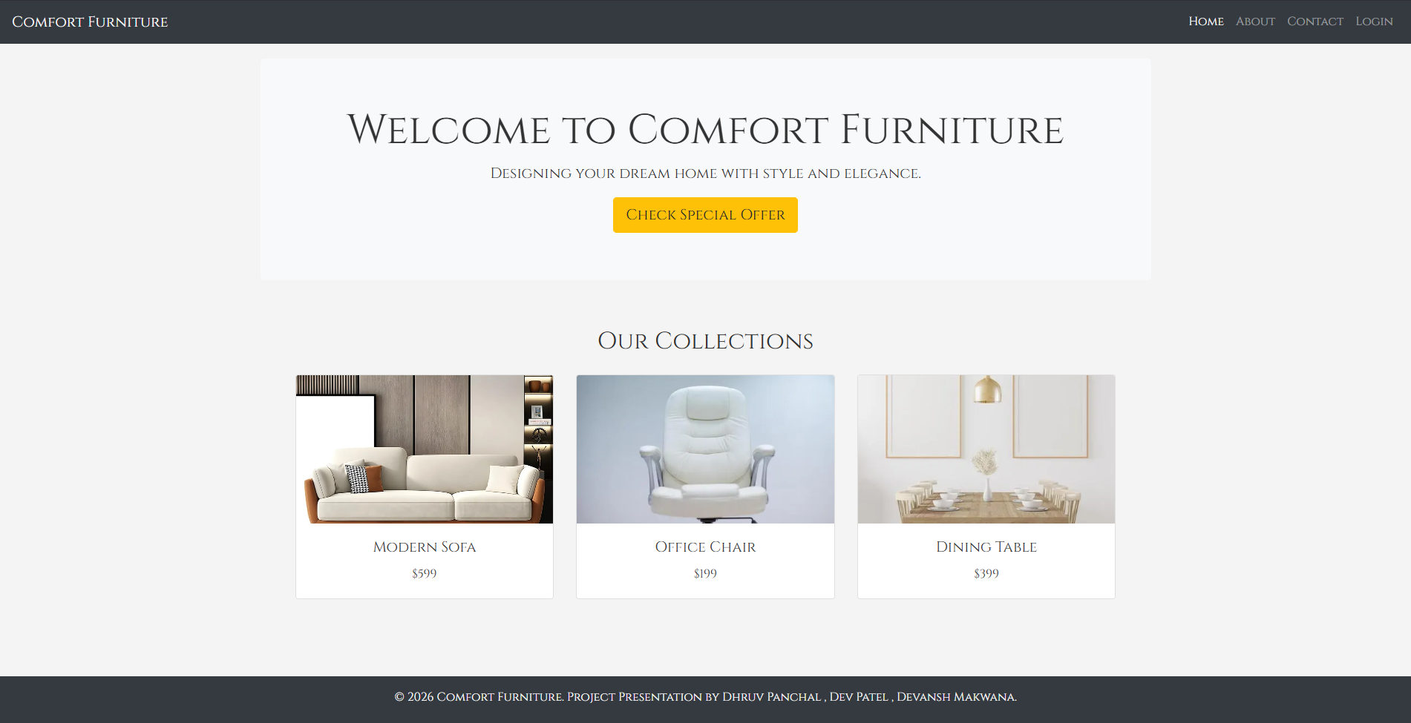

Slide 5
Home Page - Interactive Features
JAVASCRIPT FUNCTIONS:
1. Page Load Alert - Welcome message on load
2. showDiscount() - Prompt for product, shows 10% offer
3. Hover Overlay - Image overlay on product hover
CODE EXAMPLE:
function showDiscount() {
let itemName = prompt('Enter product name:');
if (itemName) {
alert('Special Offer: Get 10% off!');
}
}

Slide 6
About Page
Company Information & Delivery Schedule
COMPANY MISSION:
'We are dedicated to providing high-quality furniture for your home and office. Our mission is to blend comfort with modern design.'
DELIVERY SCHEDULE:
Monday North Zone Active
Wednesday South Zone Active
Friday West Zone Active

Slide 7
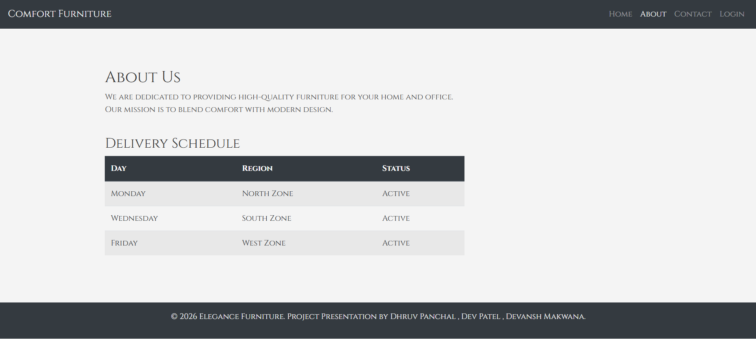

Slide 8
Contact Page
User Inquiry Form
FORM FIELDS:
Full Name (Text)
Email Address (Email)
Phone Number (Tel)
Message (Textarea)
JAVASCRIPT CONFIRMATION:
function confirmSubmission() {
if (confirm('Send this message?')) {
alert('Message Sent!'); return true;
} return false;
}

Slide 9
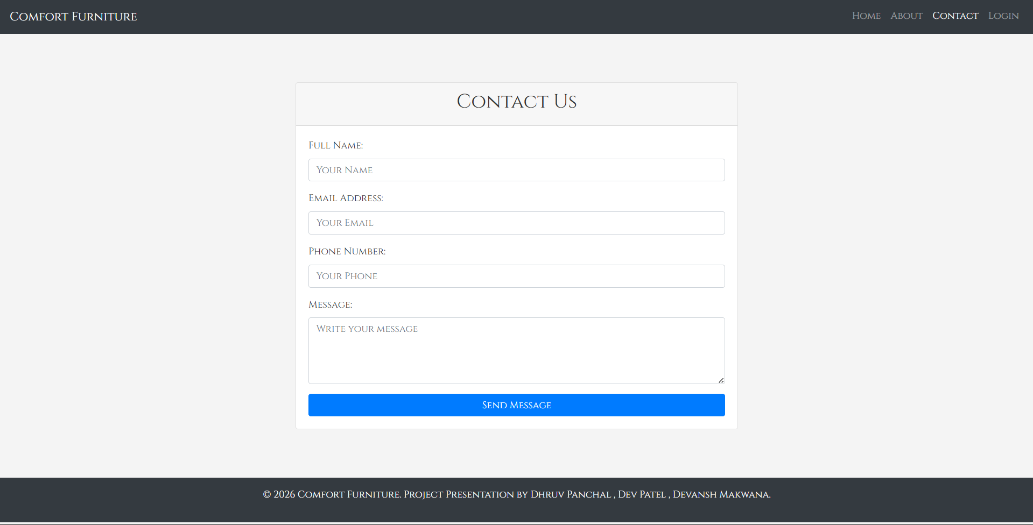

Slide 10
Login Page
User Authentication
LOGIN FORM:
Username (Text)
Password (Password)
FEATURES:
Form submits to Home page upon successful login
Clean centered card layout for focused interaction
Gateway to personalized content

Slide 11
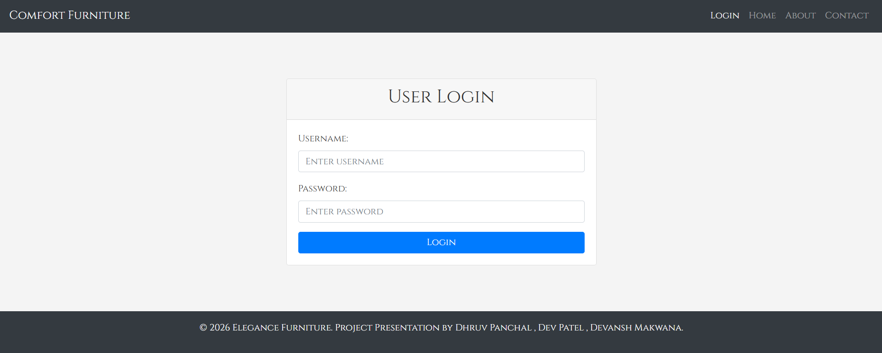

Slide 12
Registration Page
New User Account Creation
REGISTRATION FORM FIELDS:
Full Name (Required)
Email (Required)
Username (Required)
Password (Required)
Confirm Password (Required)
Phone Number (Optional)
Terms & Conditions (Required Checkbox)
USER FLOW: Registration - Agree to Terms - Redirect to Login Page
[SCREENSHOT: Insert register.html here]

Slide 13
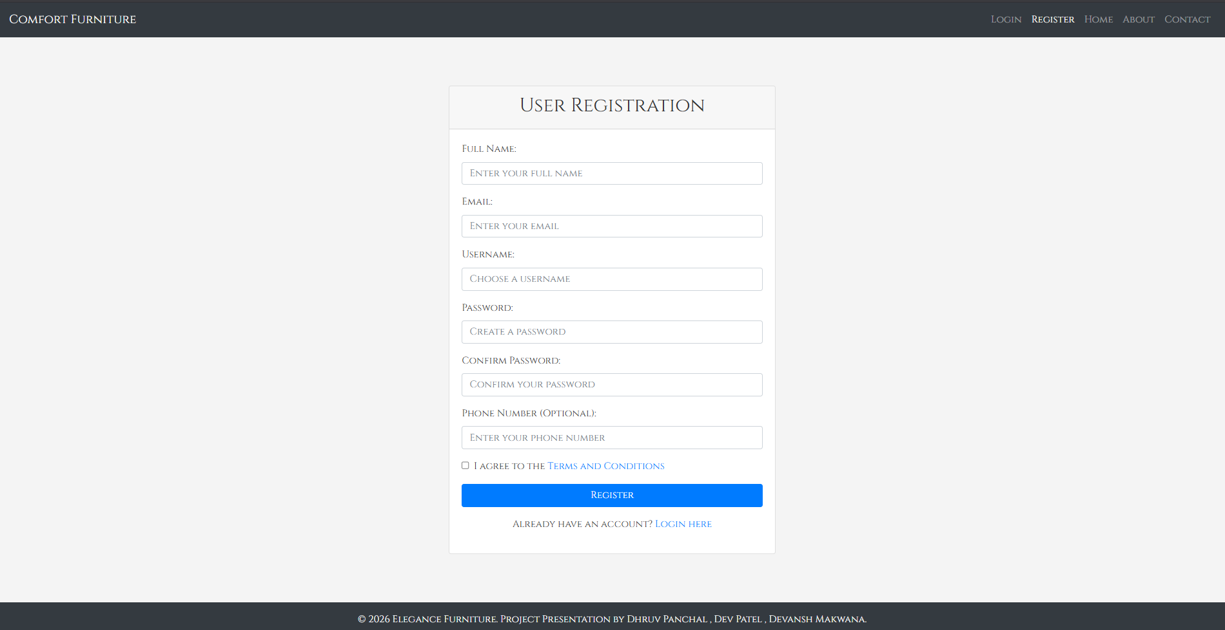

Slide 14
Key JavaScript Functionalities
Function | Purpose | Trigger
window.onload | Welcome alert | Page loads
showDiscount() | Display product offer | Button click
confirmSubmission() | Verify form submission | Form submit
Hover Effect | Show image overlay | Mouse hover
JAVASCRIPT SUMMARY:
alert() - Provides feedback to user
prompt() - Gets user input for discount
confirm() - Validates form submission

Slide 15
Responsive Design
Desktop - Tablet – Mobile
RESPONSIVE BEHAVIOR:
Desktop (>992px) ( 3-4 columns )
Tablet (768-991px) ( 2 columns )
Mobile (<768px) ( 1 column )
MEDIA QUERY EXAMPLE:
@media (max-width: 768px) {
.product-grid {
flex-direction: column;
}
}
[SCREENSHOT: Insert responsive comparison here]

Slide 16
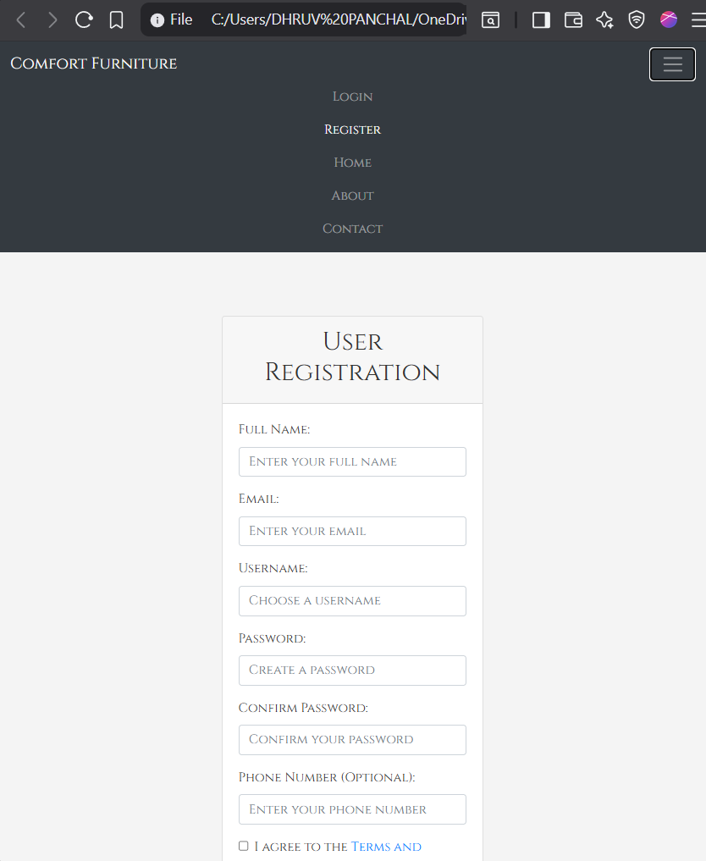

Slide 17
Project File Structure
File Name : Purpose
index.html : Home page with product showcase
about.html : Company info & delivery schedule
contact.html : Contact form with confirmation
login.html : User login interface
register.html : New user registration
style.css : Custom styling & responsive rules
script.js : JavaScript functions
EXTERNAL DEPENDENCIES:
Bootstrap 4.5 | jQuery 3.5.1 | Popper.js | Google Fonts

Slide 18
Project Achievements
COMPLETE WEBSITE STRUCTURE
Multi-page, fully functional website with consistent navigation
USER INTERFACE DESIGN
Clean, professional interface using Bootstrap and custom CSS
INTERACTIVE FEATURES
Alerts, prompts, and confirmation dialogs for user engagement
RESPONSIVE LAYOUT
Optimized display on all devices using Bootstrap grid
FORM IMPLEMENTATION
Functional forms for contact, login, and registration

Slide 19
Future Enhancements
1. SHOPPING CART
Add cart functionality with add/remove items and checkout
2. BACKEND INTEGRATION
Connect forms to server for real authentication and database
3. EMAIL FUNCTIONALITY
Configure contact form to send actual emails
4. PRODUCT DATABASE
Implement dynamic product loading from database
5. USER PROFILES
Create personalized user dashboard with order history

Slide 20
Thank You
Presented by:
Dhruv Panchal | Dev Patel | Devansh Makwana
Comfort Furniture
© 2026 All Rights Reserved

